Slide 2
Lesson Two

Slide 3
Video Discussion
1. What surprised you? 2 .Have you seen examples of this in ____ (name of city) ____? 3. Why don’t people try to stop this type of advertising? 4. What other things are advertised this way?

Slide 4
Outdoor Tobacco Advertising

Slide 5
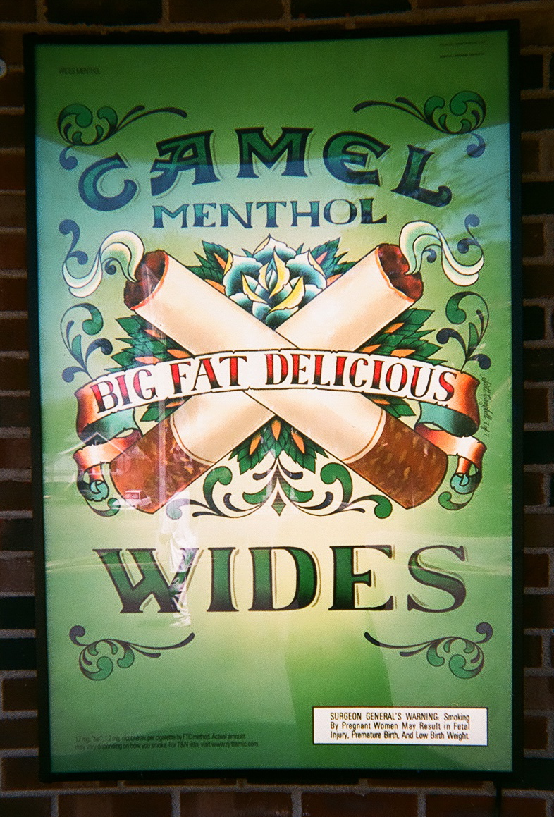

Slide 6
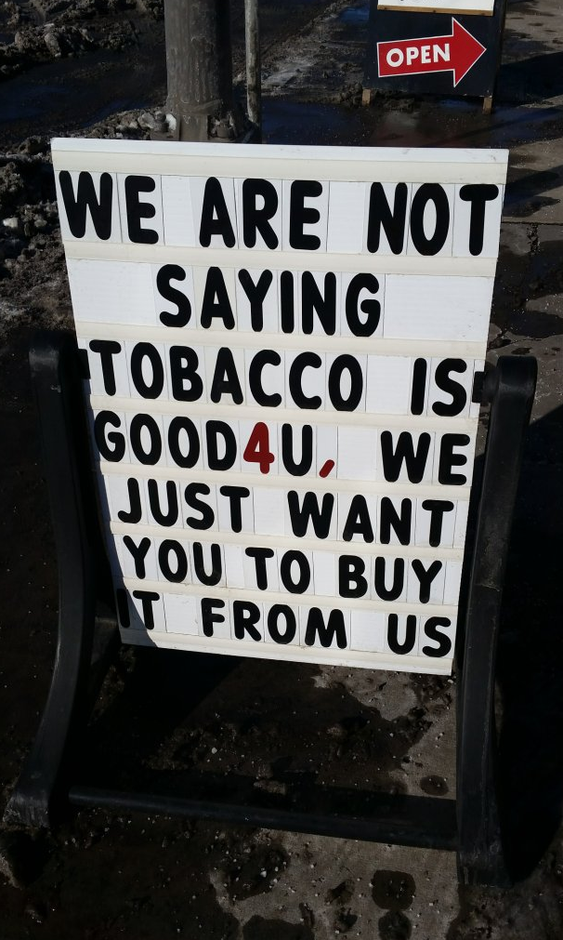

Slide 7
Indoor Tobacco Advertising

Slide 8
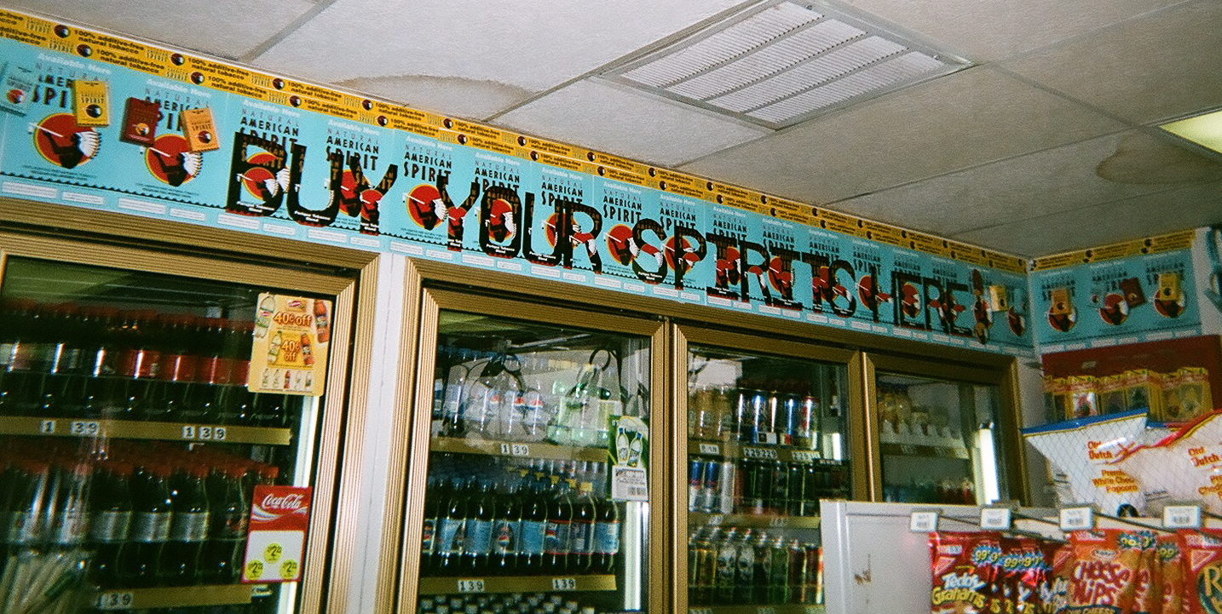

Slide 9
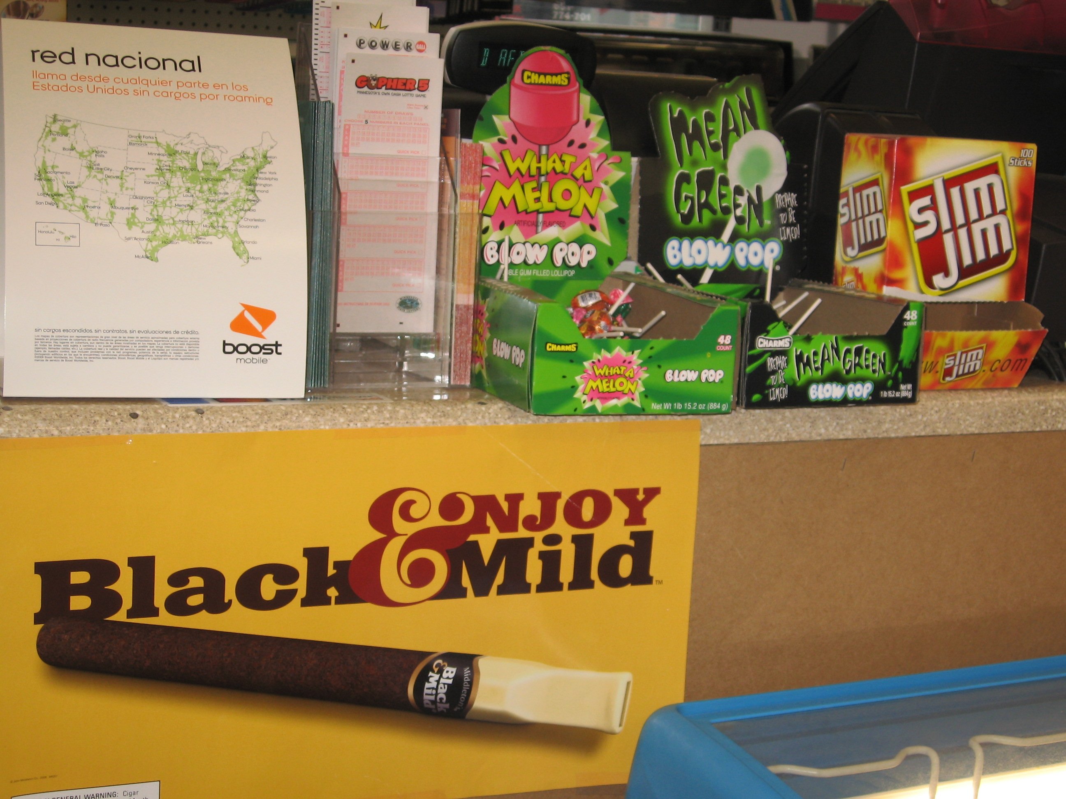

Slide 10
Tobacco Advertising on Billboards

Slide 11
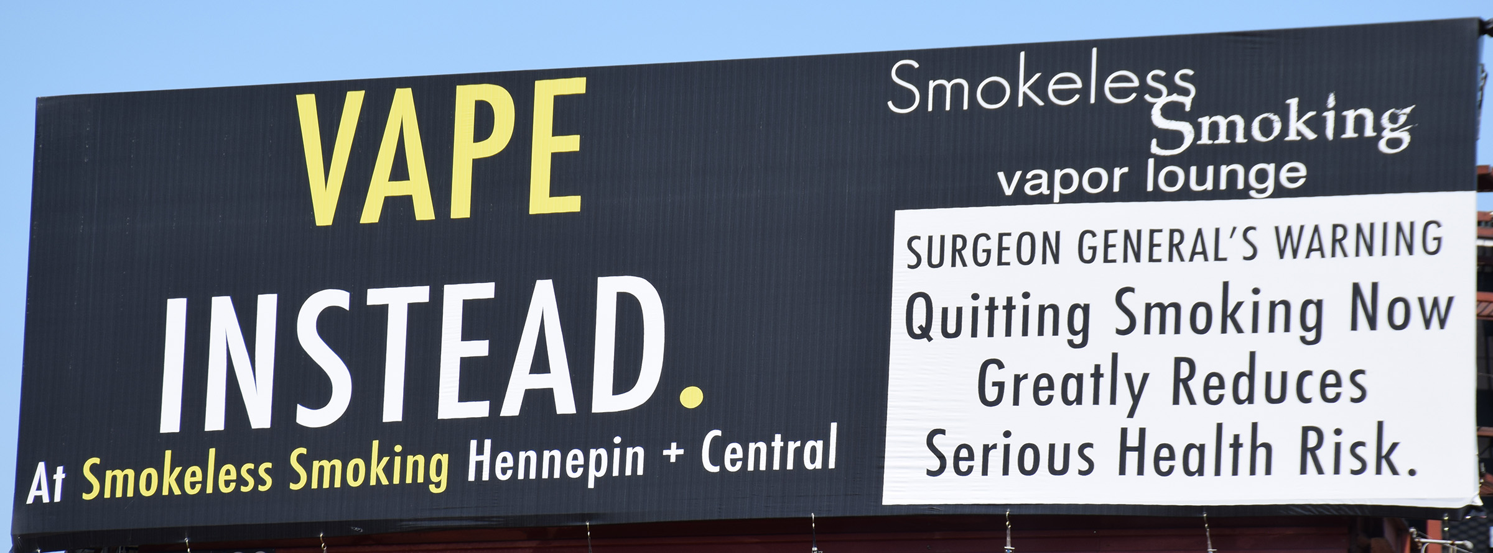

Slide 12
Tobacco Advertising Through the Mail

Slide 14
Tobacco Advertising Through Social Media

Slide 16
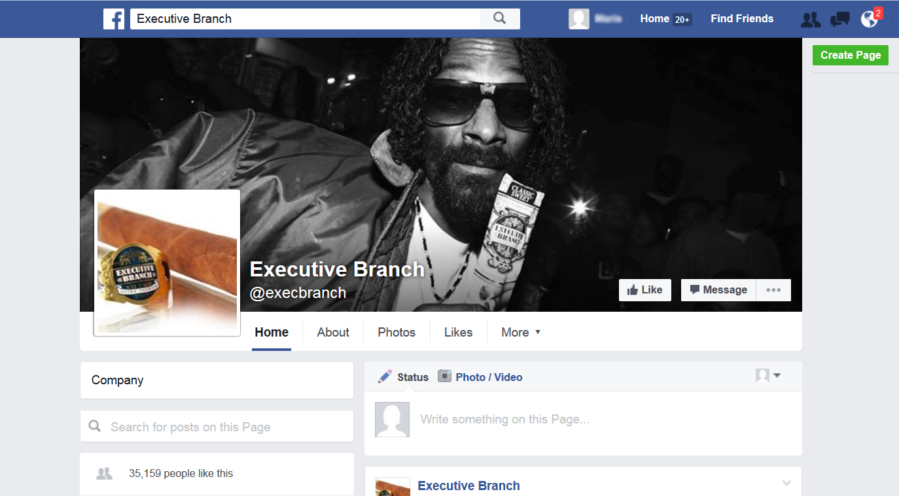

Slide 17
Tobacco Advertising in Magazines

Slide 18
Tobacco Advertising in Magazines: Discussion Questions
1. Who does this advertisement target? (i.e. age, gender, ethnicity) 2. Why is this company targeting this group? 3. How is this advertisement trying to attract this group? (look at your factsheet for help) 4. Do you think this advertisement will be successful?

Slide 19
#1
Star Magazine: October 2013

Slide 20
#2 Cosmopolitan: January, February 2007

Slide 21
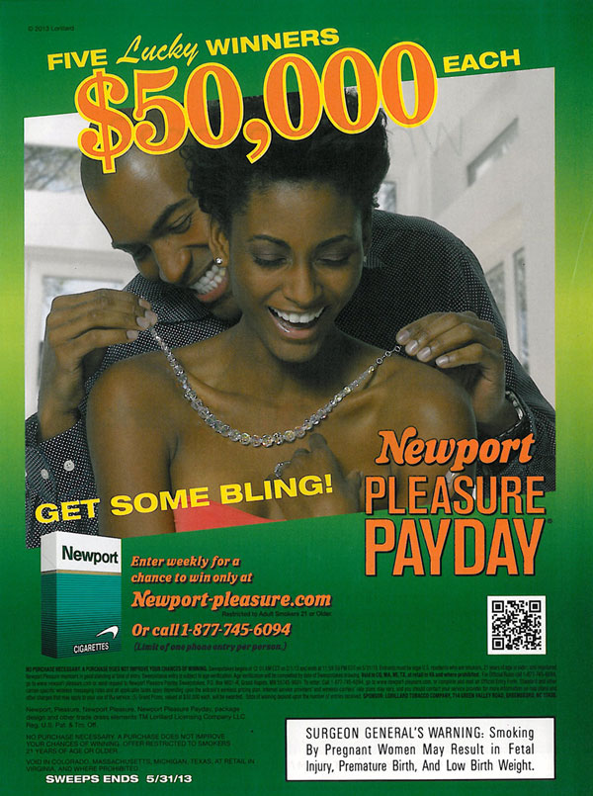
#3 Essence: March 2013

Slide 22
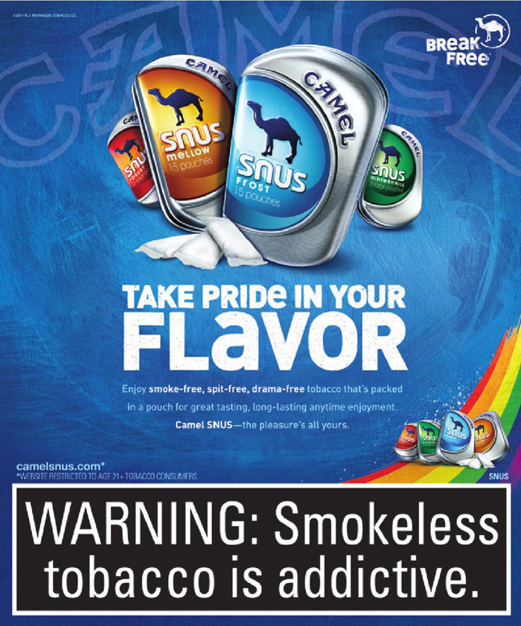
#4 Lavender (Minneapolis): October 6, 2011

Slide 23
#5 Esquire: August 2012; September 2012

Slide 24
#6 Field & Stream: July 2012

Slide 25
#7 Rolling Stone: July 2, 2015

Slide 26
#8 People: April 2013; December 2013

Slide 27
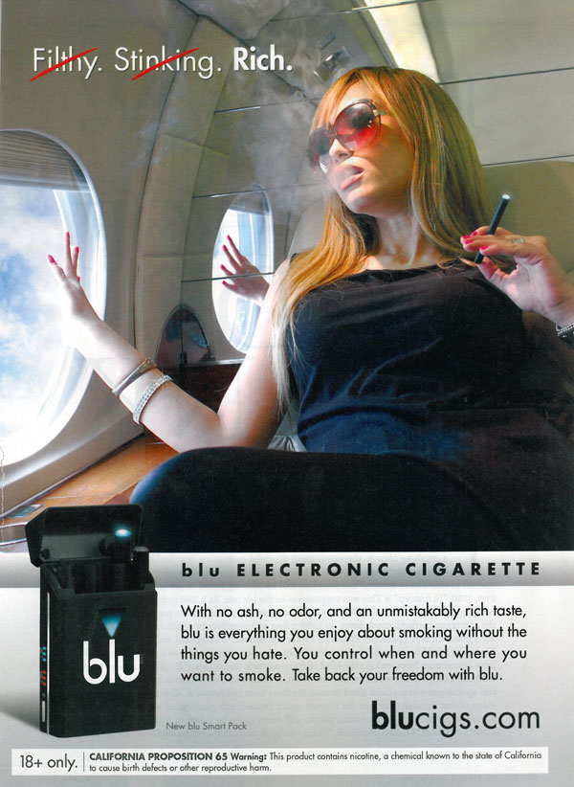
#9 Rolling Stone: May 2012

Slide 28
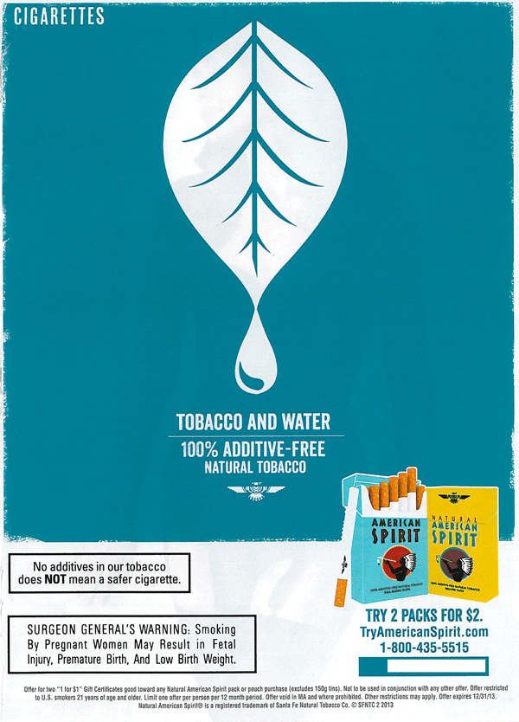
#10 Maxim: April 2013

Slide 29
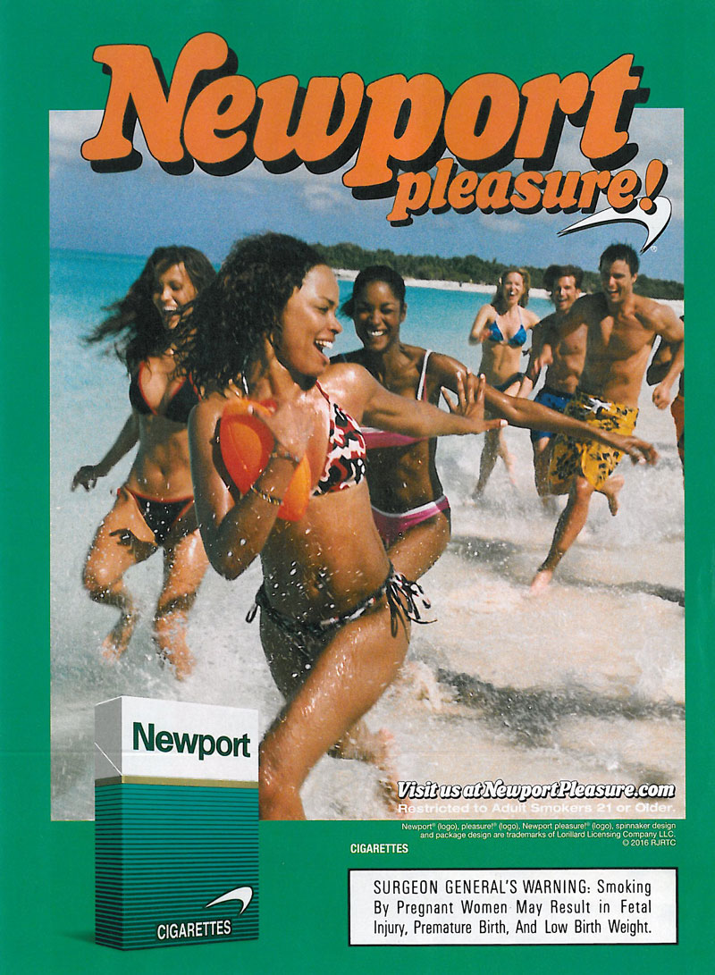
#11 Sports Illustrated: February 23, 2016

Slide 30
#12 Essence: October 2015

Slide 31
#13 Car and Driver: July 2015

Slide 32
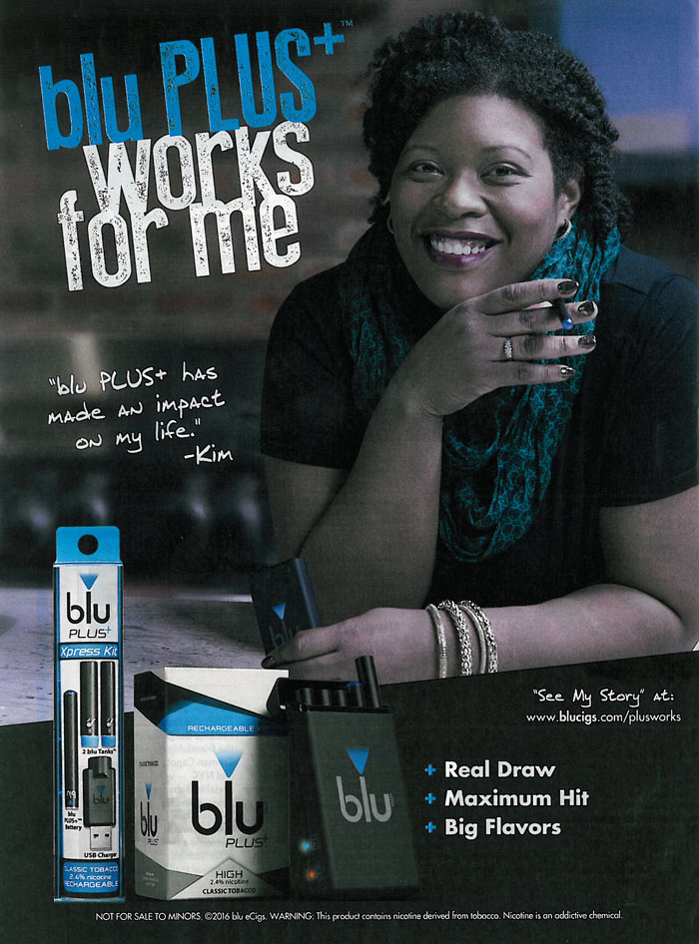
#14 Entertainment Weekly: February 19/26, 2016

Slide 33
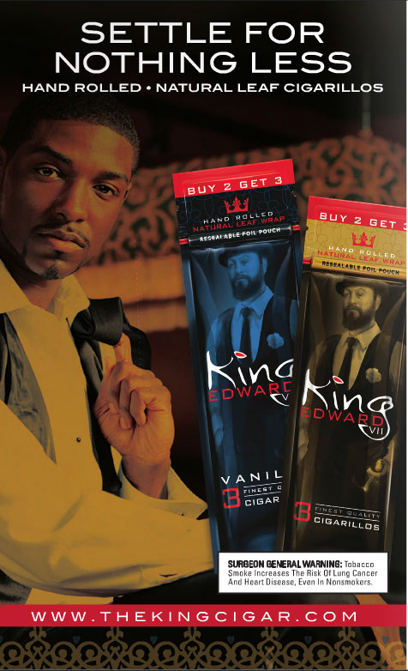
#15 Philadelphia Weekly: October 8, 2014

